Slide 1
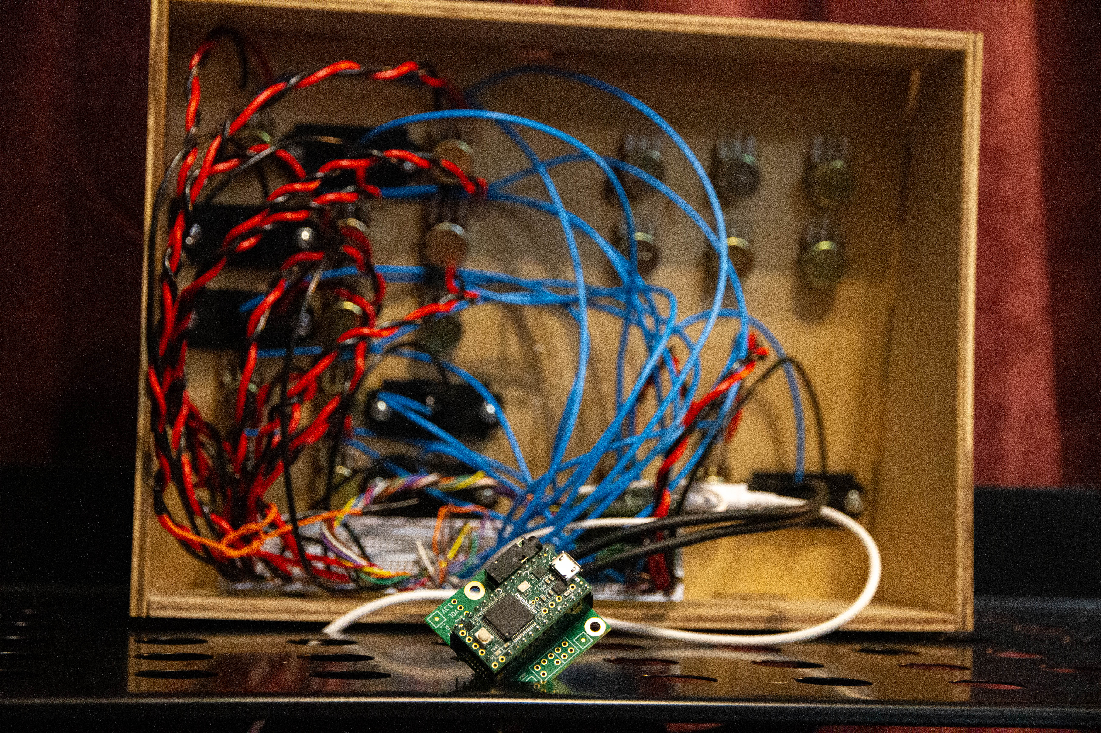
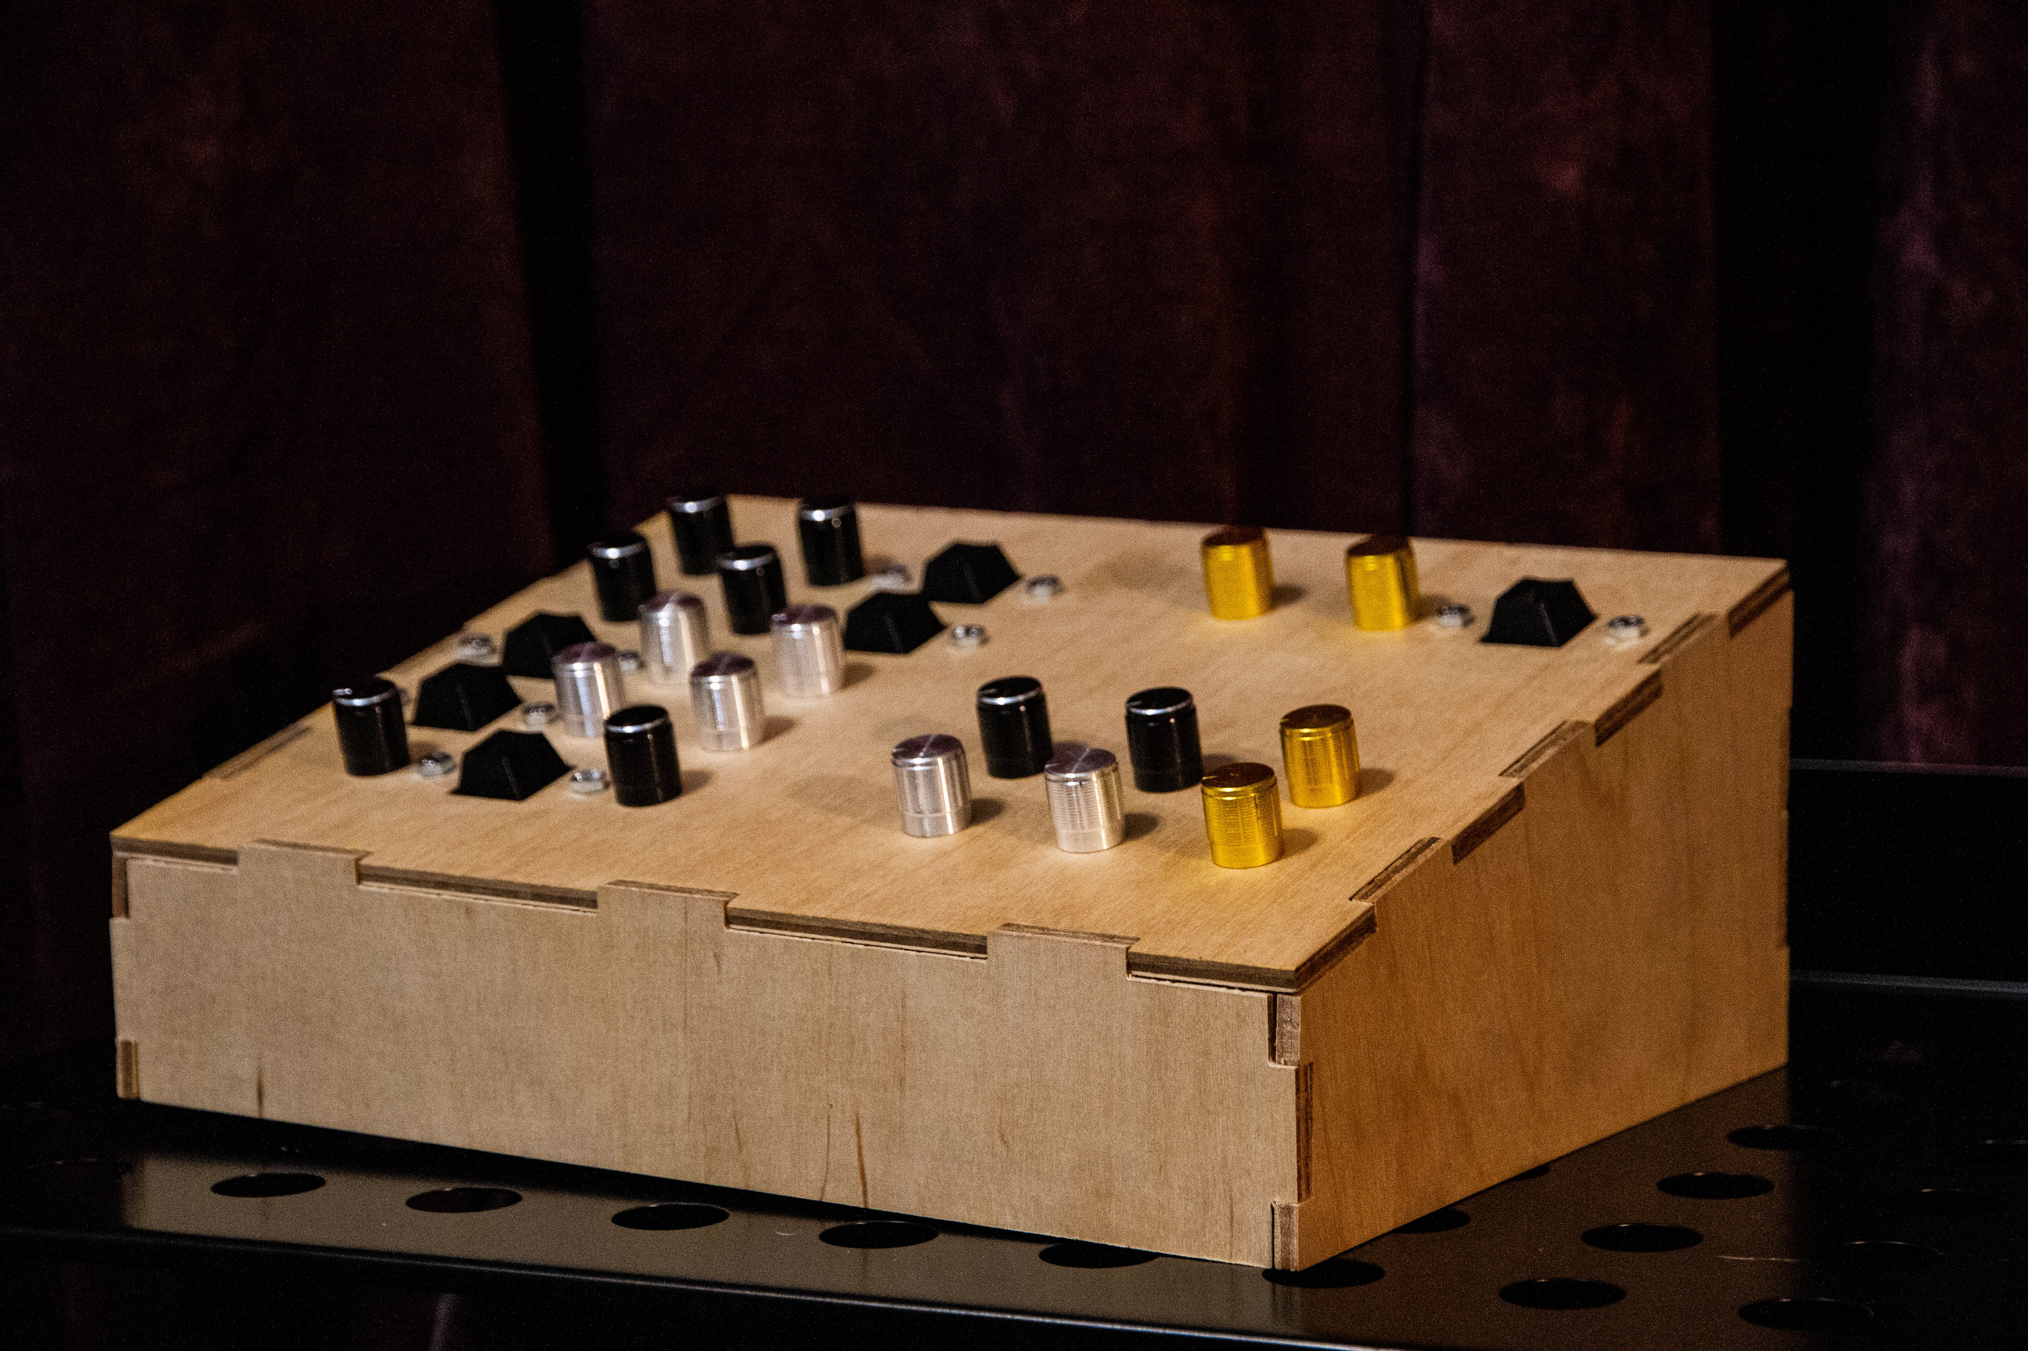
Digital Synthesis
Austin Shouli
Notes:
Hello!
-I wanted to talk about a project I have been working on. I have been building a synthesizer that runs on a microcontroller.
-First, I’m gonna talk briefly about how synthesis works.

Slide 2
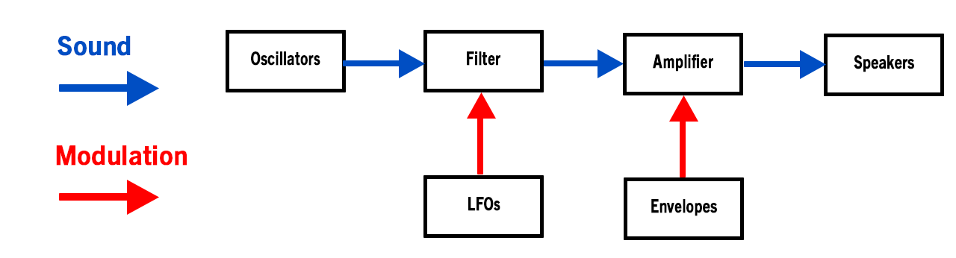
Subtractive Synthesis
Sound begins as a basic waveform – usually a triangle, square or sawtooth wave
These waveforms are created by oscillators, or stored in wavetables
Sound then passes through a filter, which removes specific frequencies
Usually a low-pass filter, meaning frequencies above the cutoff are removed
Finally, the sound passes through an amplifier and into a speaker. Things get interesting when we add modulation
Primarily Low Frequency Oscillators (LFOs) & Envelopes, although there are others
By using a modulator to change parameters we can create complex waveforms and interesting sounds
Notes:
-Synthesizers are musical instruments that generate sound electronically.
-Essentially, oscillators generate a basic waveform, which is filtered and modulated to create complex waveforms and interesting sounds.

Slide 3
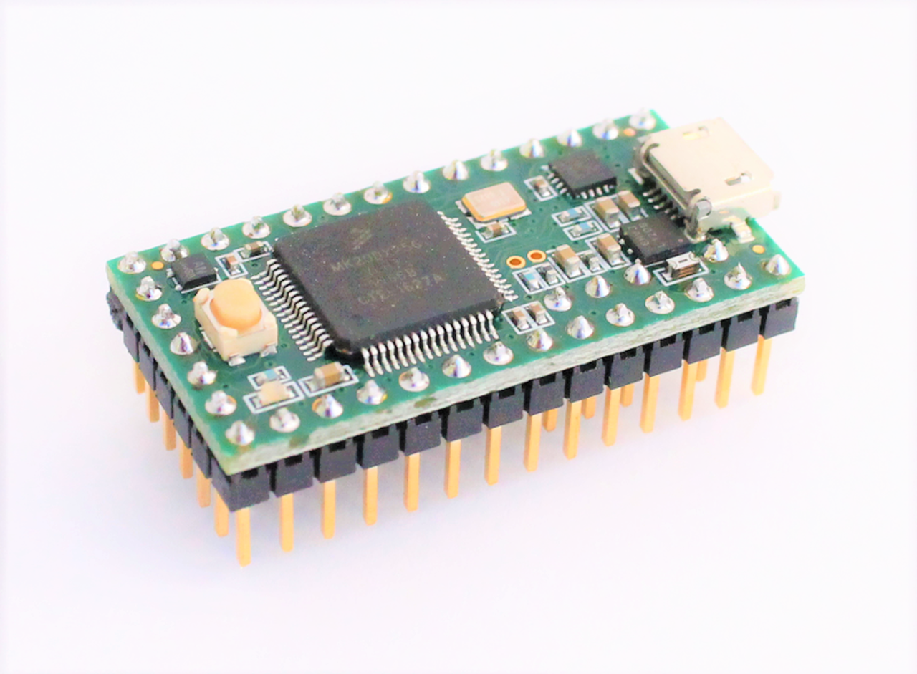
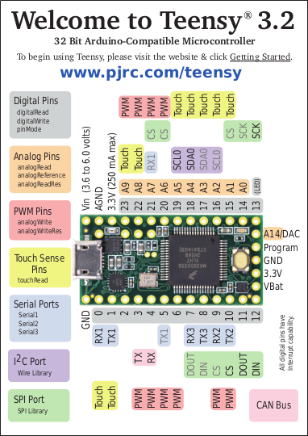
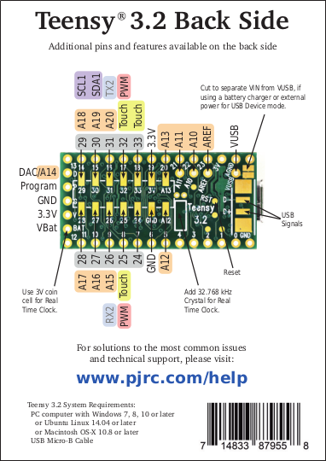
Teensy 3.2 Micro-Controller
Small, programable computer contained on a single PCB
Provides several different types of Input / Output pins
Analog, Digital, PWM, Serial, I2C, SPI, Touch Sense, USB, and a DAC Output
Can be programmed in Arduino’s C++ dialect and IDE
256K Flash, 64K RAM, 72 MHz ARM Cortex-M4
Notes:
-How many of you are familiar with an Arduino?
-A teensy is a microcontroller similar to an Arduino, that offers some additional features.
-In my case, I chose to use a Teensy 3.2 as it offers a lot of Inputs , as well as a built in DAC – OR - Digital to Analog Converter.
-This is a device that converts digital audio into analog output. You are using a DAC anytime you use the aux jack on your phone.

Slide 4
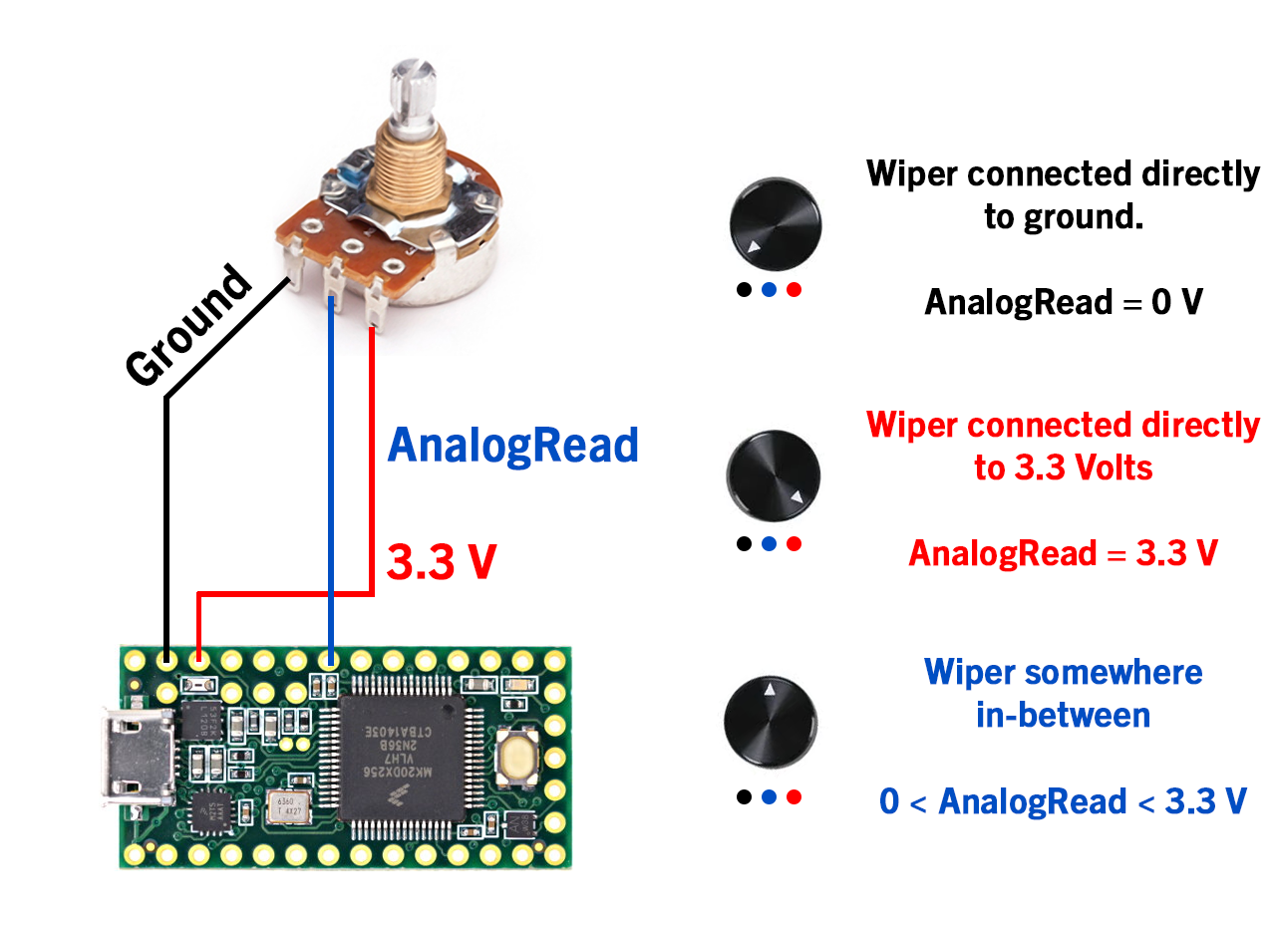
How it works
Potentiometers / analog read
A pin is connected to power, though a variable resistor (potentiometer)
Depending on the position of the potentiometer, the pin sees a different voltage
These analog pins take a 10-bit reading (0 – 1023)
If the pin sees 1.7 V, it will return a value of 527, or ~52% of 3.3 V
Therefore, the controller knows the dial is set roughly halfway
Subtitle
Open the Design Ideas pane for instant slide makeovers.
When we have design ideas, we’ll show them to you right there.
Notes:
-One of the ways the microcontroller interacts with the outside world is with a potentiometer, or variable resistor.
-Depending on the wiper’s position, the resistance between this contact and the other two changes.
-In this arrangement, the resistance between the power supply and the pin changes, and more or less of the power is sent to ground.
- An analog pin can take a reading and determine the position of the potentiometer based on the voltage the pin sees.
-This reading can be used in programming, to change a variable each loop.

Slide 5
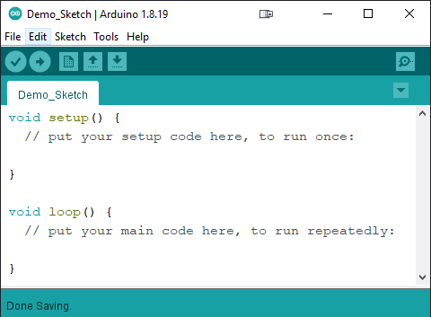
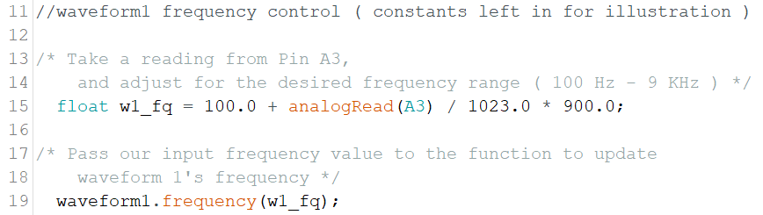
The Code
The Teensy Audio Library provides several functions for the various parts of synthesis.
We can feed our analogRead() values into other functions to make real time changes to them
In the example below, we pass an analogRead() on pin A4 to Waveform 2’s ‘update frequency’ function.
Instead of int main, we have void setup and void loop
Setup runs once, usually to take initial readings and begin functions – in this case our waveforms functions
Then loop runs, continuing indefinitely, unless a stop condition is reached.
Here we can call the analogRead() function to continuously read what is happening at a specific pin
Example
Notes:
-One difference between the C++ we have been writing in our classes, and the code on a microcontroller is the loop function.
-So far, our main function is where our program ‘runs’ from. For a microcontroller we have a void setup function, and a void loop function
The set up is where we can put code we want to run once.
The loop function acts like a while loop. Each loop checks the pins and updates variables with the readings.
This allows for the parameters to be updated each time the loop is performed.
In this case, the sound being produced is updated each loop.

Slide 6
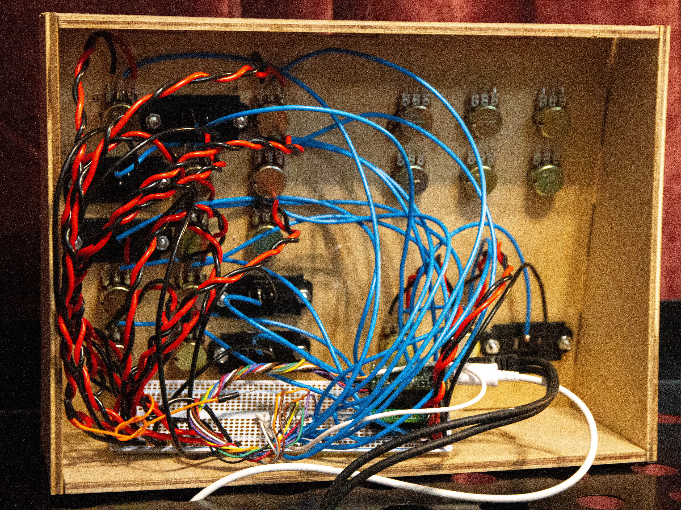
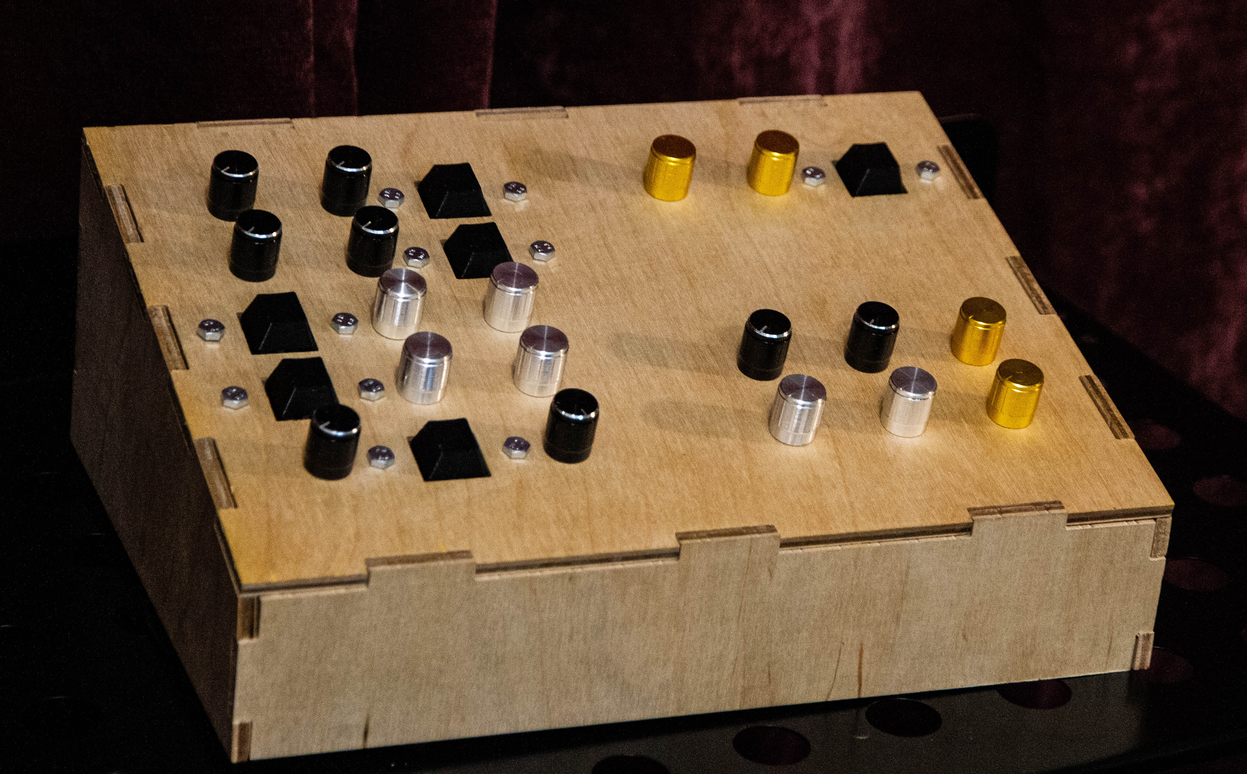
What’s Next?
The Electronics
The Code
The Design
Switch to a larger controller for additional I/O, possibly a teensy 3.6
A larger controller will also allow for more complicated DSP algorithms (Digital Signal Processing)
Incorporate MIDI jacks for connectivity to a keyboard
Design a PCB to replace point-to-point wiring
Incorporate more complex DSP algorithms
Physical MIDI In Connector
Ability to save / store / recall presets
Ability to act as an interface, routing audio not only to speakers but directly into the computer and a DAW
Step tuning mode, to lock into various established musical keys
Route additional holes for mounting power, MIDI, audio ports and a screen or 8-segment display
Iterate towards a bespoke, commercial quality case
Design custom MX Keycaps with illustrations
Add LED’s to indicate states of various functions (current waveform, LFO Routing, etc.)
Notes:
_I would like to continue to develop this.
- While the Teensy Audio Library is excellent, I would like to develop my own signal processing (DSP) Algorithms
I would also like to improve the wiring, as I was running out of time for this project and did a pretty messy job!

Slide 7
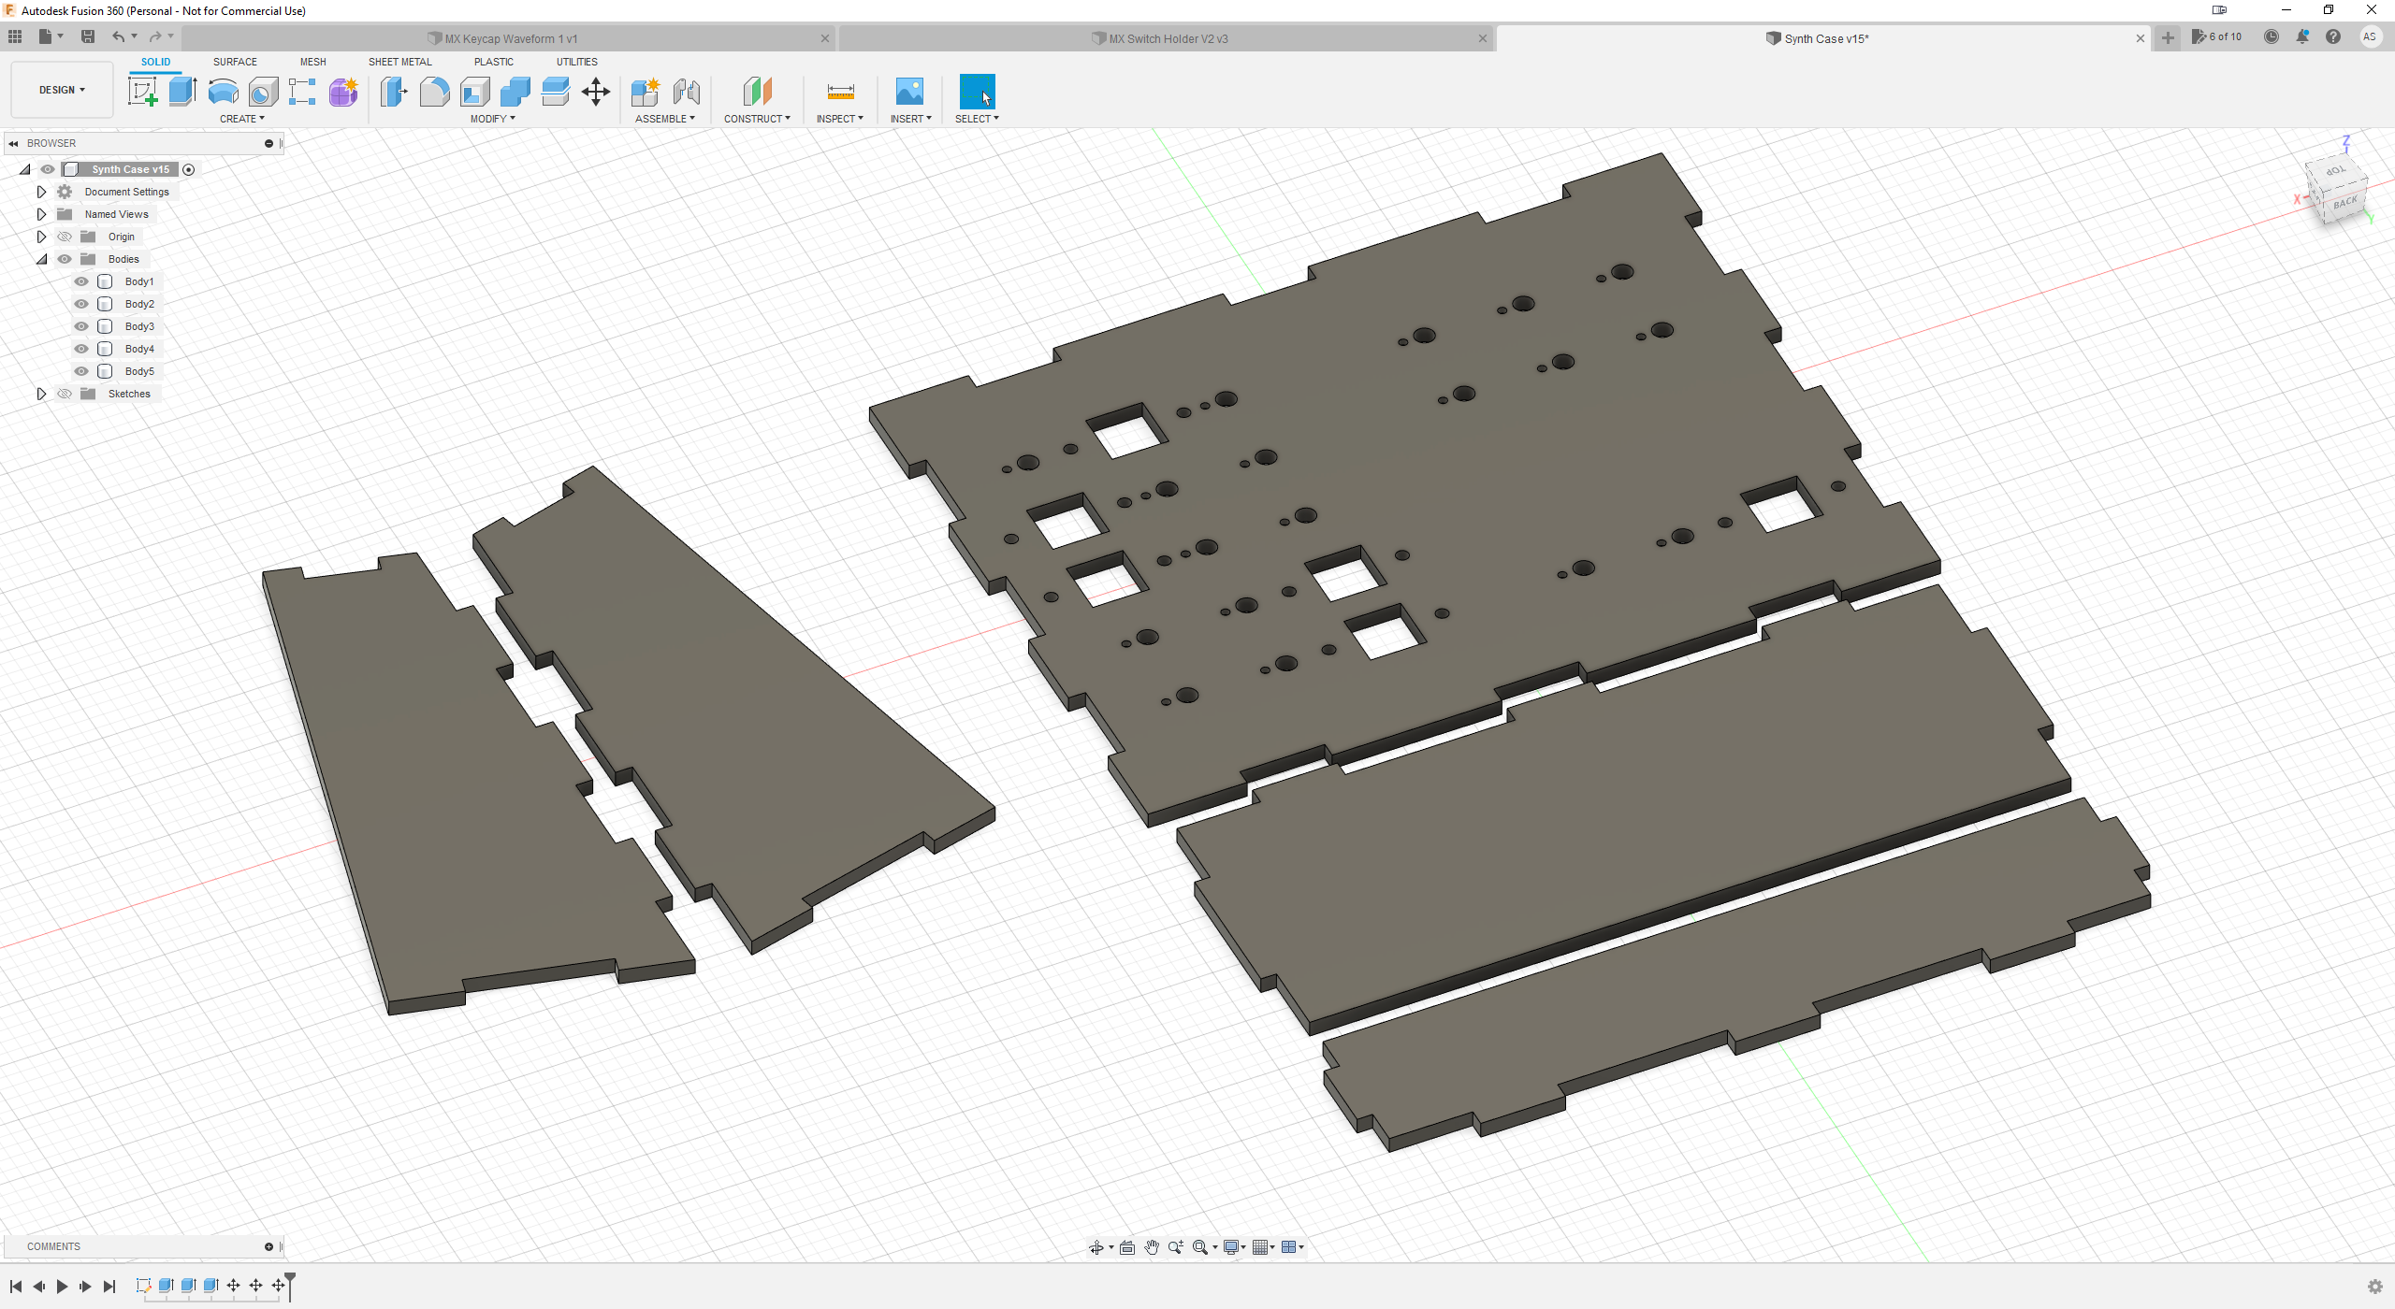
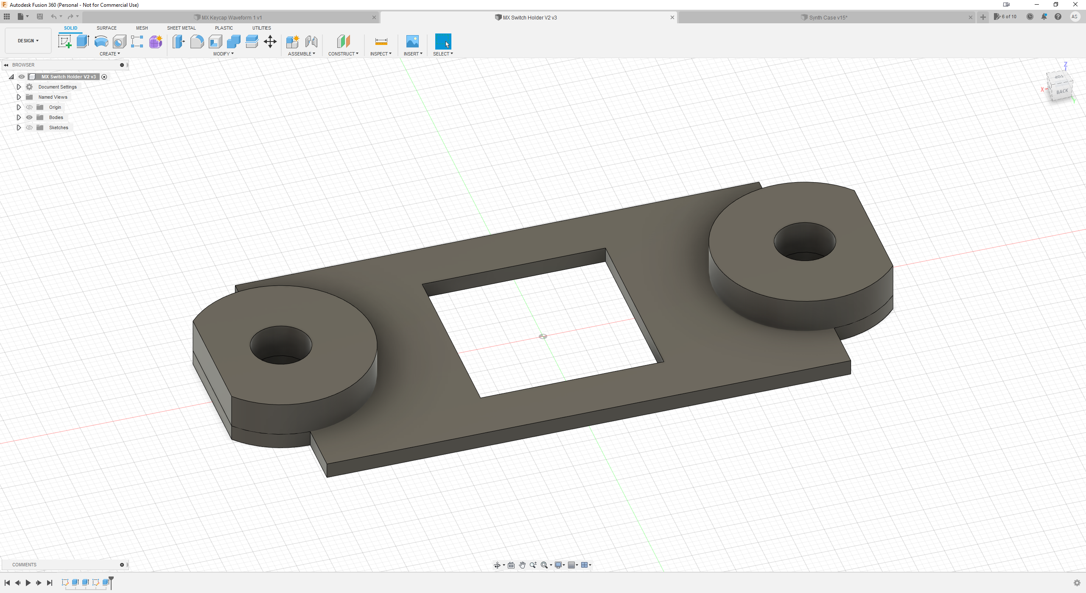
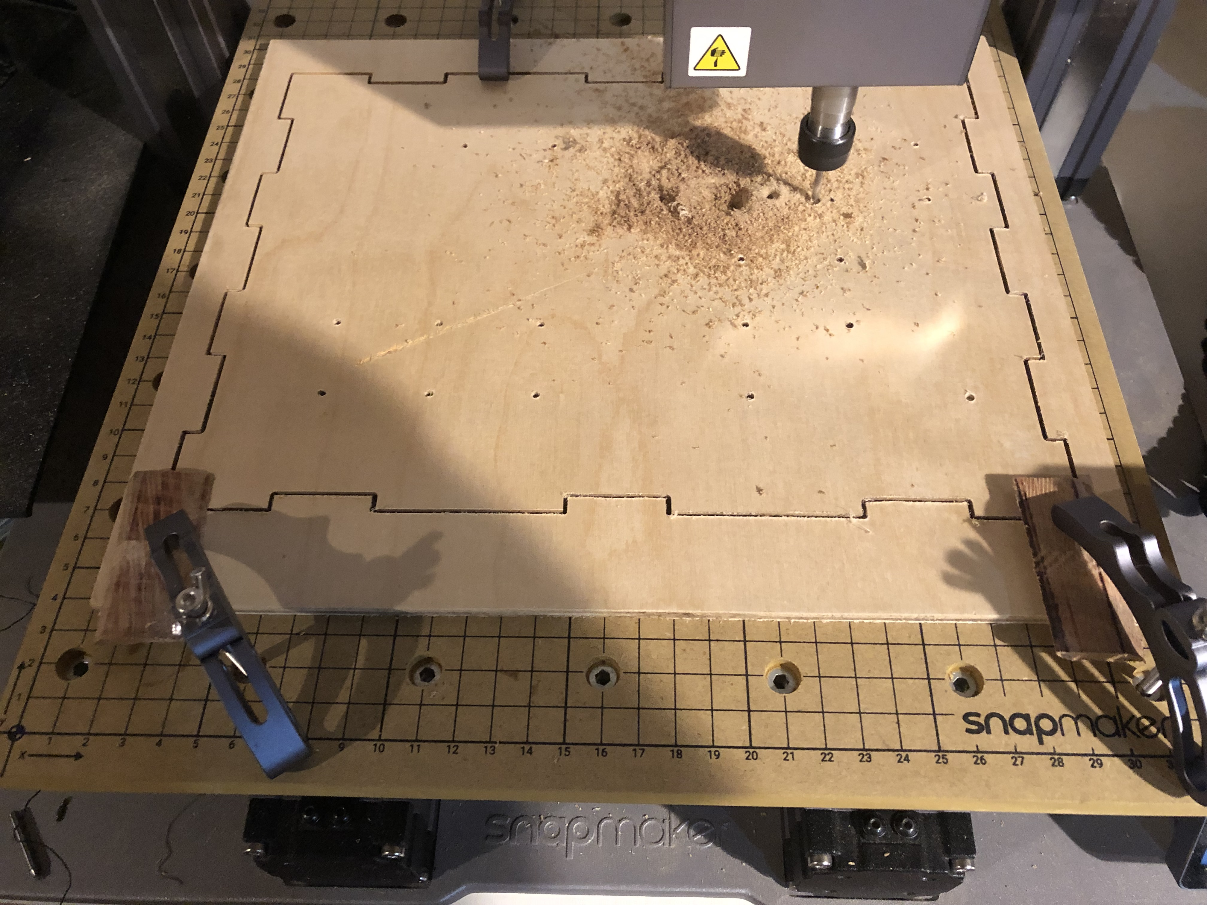
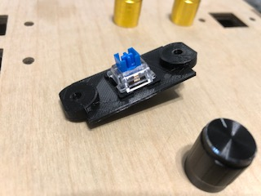
Thank You
Notes:
I’m now going to play a video demonstration!
Thanks everyone – are there any questions?
Okay – Thanks again.

